Slide 1

Sandip Foundation’s
Sandip Institute of Technology and Research Centre (SITRC)
Department of Electronics and Telecommunication (E&TC) Engineering Academic Year 2021-22
A PROJECT PRESENTATION ON
Covid-19 Identification Using Chest X-Rays
BY
1. SHUBHANGI MORE
2. RITIKA PATIL
3. DURGESH RAMAIYA
GUIDED BY
PROF.S.D.PAWAR

Slide 2
INDEX
Introduction
Problem statement
Literature survey
Objective
Block diagram
Flowchart
Methodology
Hardware/Software
Advantages
Applications
Future scope
References

Slide 3
INTRODUCTION
With the recent rapid growth of the technological advancements, medical science has also improved. But medical science is dependable on the current improvement of technologies.
The recently discovered Corona-virus pneumonia, dubbed COVID-19, is extremely transmissible as well as pathogenic. For the treatment, Currently there is no licensed antiviral medication or any vaccination.

Slide 4
INTRODUCTION
From December 2019, pneumonia patients have found in some hospitals in Wuhan city, Hubei Province which have now been confirmed as a coronavirus.

Slide 5
OBJECTIVE
To detect covid-19 patient using chest x-rays.
Take chest x-ray of patient,
a . Comparing this x-ray with infected and non-infected x-rays
b . Then, identify covid patient x-rays
Using convolutional neural network.

Slide 6
PROBLEM STATEMENT
Brain Tumor is an abnormal growth of cells in the human brain which can prove to be fatal.
Traditionally, radiologists have been using a manual method to identify the tumor from an MRI.
This method is very risky considering the inaccuracy of his assumption in identification of the tumor and the long time taken to derive the results.
So we bring forth, an accurate and fast computer aided brain tumor segmentation from MRI data using Image Processing techniques.

Slide 7
LITERATURE SURVEY
Sr. no. | Year | Title | Author Name | Methodology | Outcome | Drawbacks
1 | 2020 | image-classification-using-convolutional-neural-network .[1] | Hardik Deshmukh | Convolutional-Neural-Network | - | -
2 | 2020 | Detection of COVID-19 from Chest X-Ray Images Using Convolutional-Neural- Networks[2] | Boran Sekeroglu and Ilker Ozsahin | Convolutional-Neural- Networks | - | -

Slide 8
LITERATURE SURVEY
Sr. no. | Year | Title | Author Name | Methodology | Outcome | Drawbacks
3 | 2020 | Automatic X-ray COVID-19 Lung Image Classification System based on Multi- Level Thresholding and Support Vector Machine. [3] | Aboul Ella Hassanien Sr., Lamia Nabil Mahdy Jr., Kadry Ali Ezzat Jr., Haytham H. Elmousalami Jr., Hassan Aboul Ella Jr. | Multi-Level-Thresholding And Support-Vector- Machine | It consume less time as compare to medical imaging technique(RT-PCR) | SVM algorithm is not suitable for large data sets. SVM does not perform very well when the data set has more noise
4 | 2020 | Within the Lack of Chest COVID-19 X-ray Dataset: A Novel Detection Model Based on GAN and Deep Transfer Learning.[4] | Mohamed Loey, Florentin Smarandache, Nour Eldeen M. Khalifa | GAN and Deep Transfer Learning | Three scenorios are used so touches more accurancy . | Their final conclusion on the produced confusion matrices rather than the accuracy results due to the unbalanced data.

Slide 9
LITERATURE SURVEY
Sr. no. | Year | Title | Author Name | Methodology | Outcome | Drawbacks
5 | 2020 | COVID-Net:ATailored Deep Convolutional-Neural-Network Design for Detection of COVID-19 Casesfrom Chest X-Ray Images.[5] | LindaWang, ZhongQiuLin and Alexander Wong | Deep Convolutional-Neural-Network | - | -

Slide 10
OUTCOME OF LITERATURE SURVEY
Multilevel Thresholdind and SVM: It involves the Median filtering.
GAN And Deep Transfer Learning: It involves GAN technic and 3 different modules.

Slide 11
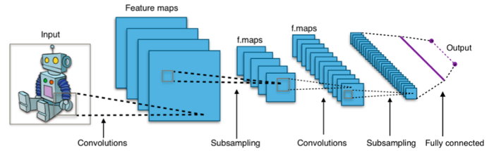
DIAGRAM

Slide 12
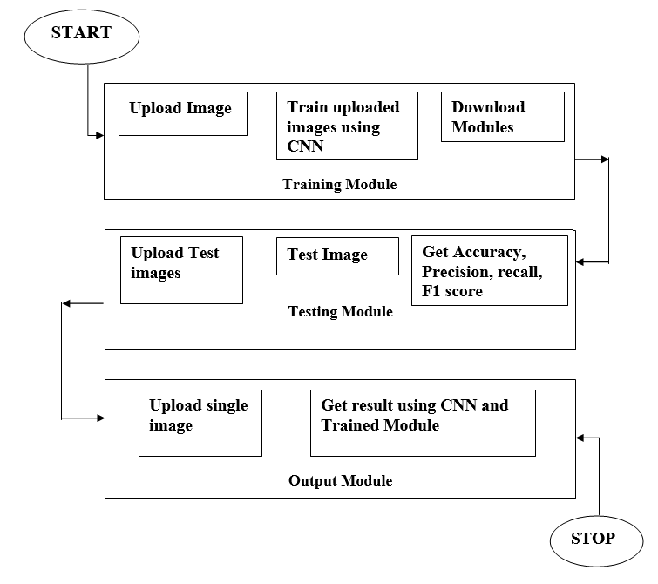
METHODOLOGY

Slide 13
Training Phase: Step 1: Upload images and add labels to it with two classes: positive and negative. Step 2: Resize each image to 64 x 64 pixels. Step 3: Follow the steps below to train pictures using the CNN algorithm. A loss graph and model summary will be generated once the training is complete. Step i: Set your Neural-Network options. Step ii: Initialize your Neural-Network. Step iii: Prepare the data for normalization and train the CNN model. Step iv: Classify the data using the train Step 5: If the model is tested using testing images, the confusion matrix, accuracy, precision, and recall of the pretrained model will be returned. The stages of the CNN algorithm will be followed in the testing model. Step i: Load the pre-trained model, weights, and metadata. Step ii: Write a function to deal with the classification outcomes
METHODOLOGY

Slide 14
Step 6: A single image prediction will be performed in the output model. The output model will perform the steps of the CNN algorithm. Step i: Load the pre-trained model, weights, and metadata. Step ii: Write a function to deal with the classification outcomes.
METHODOLOGY

Slide 15
FLOWCHART

Slide 16
Hardware/Software
Software :
Python
OpenCv
Pillow library which is the python image library that adds image processing capabilities to python interpreter,numpy library for numerical operations which uses matlab style syntax.
The tensorflow model can be used to detect if the MRI image contains tumor or not and imutils function for basic image processing functions.
Hardware :
i3 processor and above.
Operating system : Windows 10

Slide 17
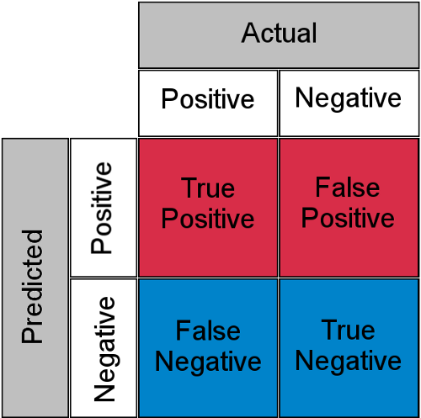
WORK DONE
Accuracy = 𝑇𝑟𝑢𝑒𝑃𝑜𝑠𝑖𝑡𝑖𝑣𝑒+𝑇𝑟𝑢𝑒𝑁𝑒𝑔𝑎𝑡𝑖𝑣𝑒 (𝑇𝑟𝑢𝑒𝑃𝑜𝑠𝑖𝑡𝑖𝑣𝑒+𝐹𝑎𝑙𝑠𝑒𝑃𝑜𝑠𝑖𝑡𝑖𝑣𝑒)+(𝑇𝑟𝑢𝑒𝑁𝑒𝑔𝑎𝑡𝑖𝑣𝑒+𝐹𝑎𝑙𝑠𝑒𝑁𝑒𝑔𝑎𝑡𝑖𝑣𝑒)
[1] Precision = 𝑇𝑟𝑢𝑒𝑃𝑜𝑠𝑖𝑡𝑖𝑣𝑒 (𝑇𝑟𝑢𝑒𝑃𝑜𝑠𝑖𝑡𝑖𝑣𝑒+𝐹𝑎𝑙𝑠𝑒𝑃𝑜𝑠𝑖𝑡𝑖𝑣𝑒)
(2) Recall = 𝑇𝑟𝑢𝑒𝑃𝑜𝑠𝑖𝑡𝑖𝑣𝑒 (𝑇𝑟𝑢𝑒𝑃𝑜𝑠𝑖𝑡𝑖𝑣𝑒+𝐹𝑎𝑙𝑠𝑒𝑁𝑒𝑔𝑎𝑡𝑖𝑣𝑒)
(3) F1 Score = 2* 𝑃𝑟𝑒𝑐𝑖𝑠𝑖𝑜𝑛∗𝑅𝑒𝑐𝑎𝑙𝑙 (𝑃𝑟𝑒𝑐𝑖𝑠𝑖𝑜𝑛+𝑅𝑒𝑐𝑎𝑙𝑙)

Slide 18
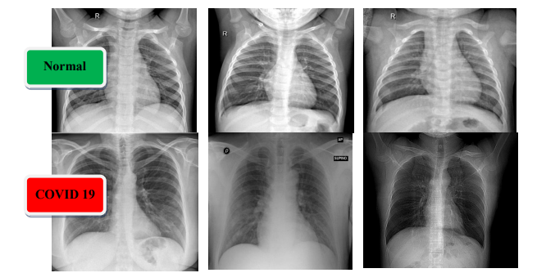
STEP 1: INPUT IMAGE
DATA SET

Slide 19
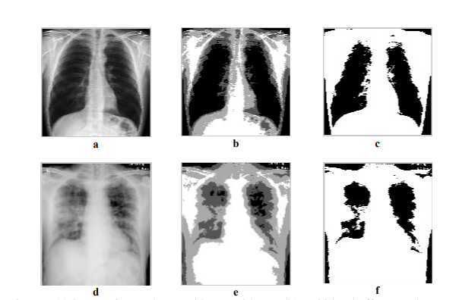
STEP 2: THRESHOLDING

Slide 20
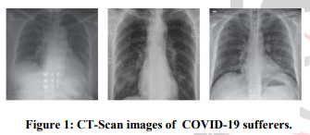
STEP3: SEGMENTATION

Slide 21
Conclusion
With these method researchers are thinking to combine X-Ray methodology for diagnosing and Imaging an accurate result, which will also reduce the work load of doctors too, and will also help to avoid direct contact with the infected patients.

Slide 22
ADVANTAGES
More accurate than physical aided means of the clinical experts.
Less time consuming than the radiologists' analysis.
Reduces the complexity of tedious methodology for detection.
MRI is chosen over CT scan, hence the exposure of the patient under the radiations is reduced.

Slide 23
APPLICATION
Used by Doctors as well as patients for better understanding and analyzing covid patient.

Slide 24
FUTURE SCOPE
DeTrac deep CNN method which approved for classification of Covid-19 images in comprehensive dataset of chest X-Ray images. DeTrac showed effective and robust results for classifying the covid-19 cases and collection of accurate data. In future we can extend it to validating method with larger datasets and can add deep collection of data component to enhance the usability of model.

Slide 25
REFERENCES
[1] HardikDeshmukh,”image-classification-using-convolutional-neural-network “,7-Nov-2020,https://towardsdatascience.com/medical-x-ray-%EF%B8%8F-image-classification-using-convolutional-neural-network-9a6d33b1c2a. [2] Boran Sekeroglu and Ilker Ozsahin , ”Detection of COVID-19 from Chest X-Ray Images Using Convolutional Neural Networks”,pp.1-13,18-sept-2020, Research Article , https://doi.org/10.1177%2F2472630320958376. [3] Aboul Ella Hassanien Sr., Lamia Nabil Mahdy Jr., Kadry Ali Ezzat Jr., Haytham H. Elmousalami Jr., Hassan Aboul Ella Jr. ,“Automatic X-ray COVID-19 Lung Image Classification System based on Multi- Level Thresholding and Support Vector Machine”, pp.1-8,medRxiv, 2020), doi:https://doi.org/10.1101/2020.03.30.20047787. [4] Mohamed Loey, Florentin Smarandache, Nour Eldeen M. Khalifa,"Within the Lack of Chest COVID-19 X-ray Dataset: A Novel Detection Model Based on GAN and Deep Transfer Learning.",pp.1-19, Symmetry, 2020, 12(4),651://doi: https://doi.org/10.3390/sym12040651 [5] Catrin Sohrabi, Ahmed Kerwan, Zaid Alsafi, Riaz Agha, “World Health Organization Declares Global Emergency: A review of the 2019 novel coronavirus [Covid-19]”. pp- 1 to 6, doi.org/10.1016/j.ijsu.2020.02.034 Published – 3 March [Wuhan-China] [6] LindaWang1,2,3*,ZhongQiuLin1,2,3,andAlexanderWong1,2,3,”COVID-Net:ATailored Deep Convolutional Neural Network Design for Detection of COVID-19 Casesfrom Chest X-Ray Images.”pp.1-12arXiv:2003.09871v4[eess.IV]11May2020

Slide 26
[7] SnehalR.Sambhe,#Dr.KamleshA.Waghmare,“Machine Learning Framework to Detect Corona Virus -A Study with CT scan Image Of Suspected Individuals.”,pp.1-4,ISSN:2454-9150Vol-07,Issue-03, (JUNE2021) [8] KaiLiua,1,∗,YingChenb,1,RuzhengLinc,KunyuanHanc,”Clinical features of COVID-19 in elderly patients:A comparison with young and middle-aged patients.”pp.1-5,Journal of infection(27 March 2020).https://doi.org/10.1016/j.jinf.2020.03.005

Slide 27
THANK YOU…

